Slide 1
Module 5.5: Security User Interface

Slide 2
Security User Interface
When is it safe to type my password?

Slide 3
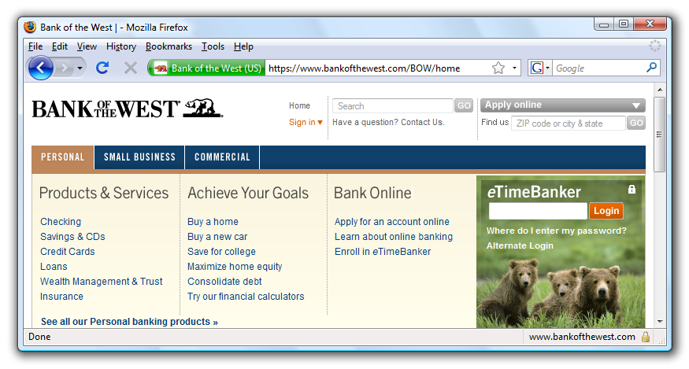
Safe to type your password?

Slide 4
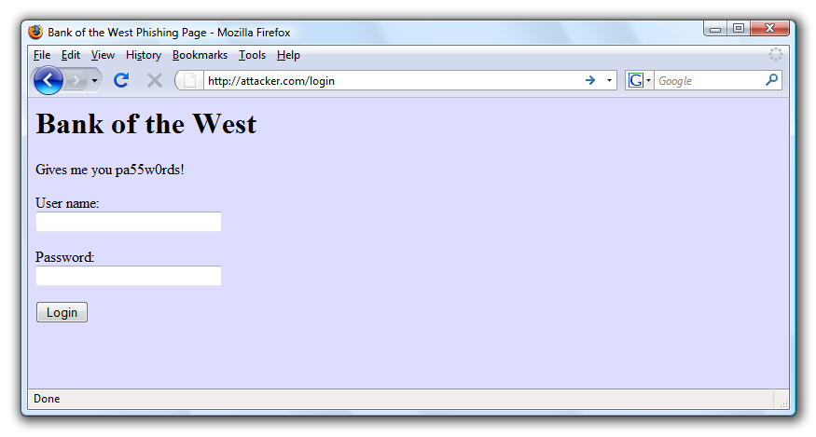
Safe to type your password?

Slide 5
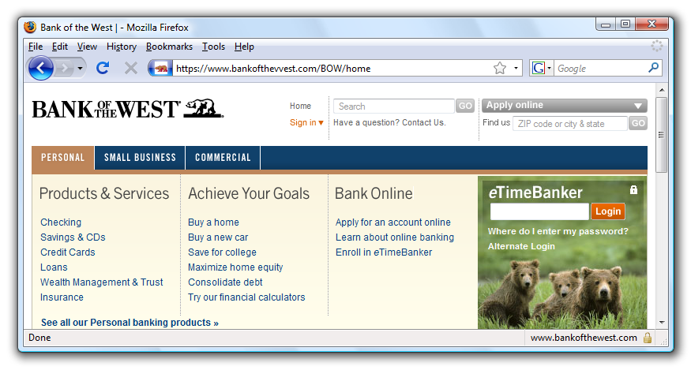
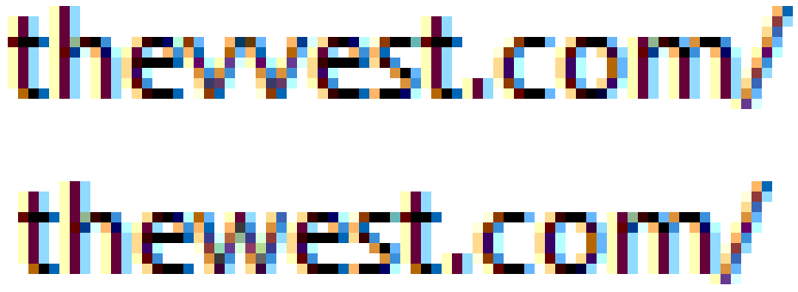
Safe to type your password?

Slide 6
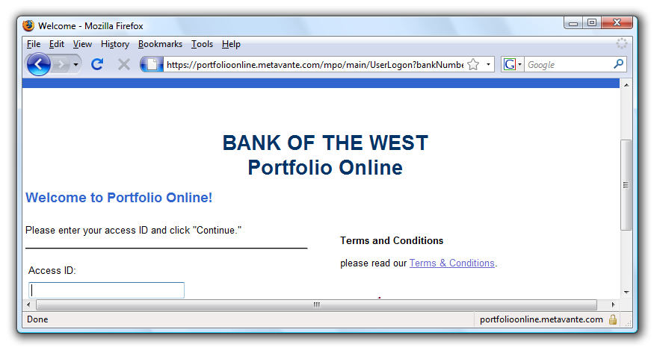
Safe to type your password?
???
???

Slide 7
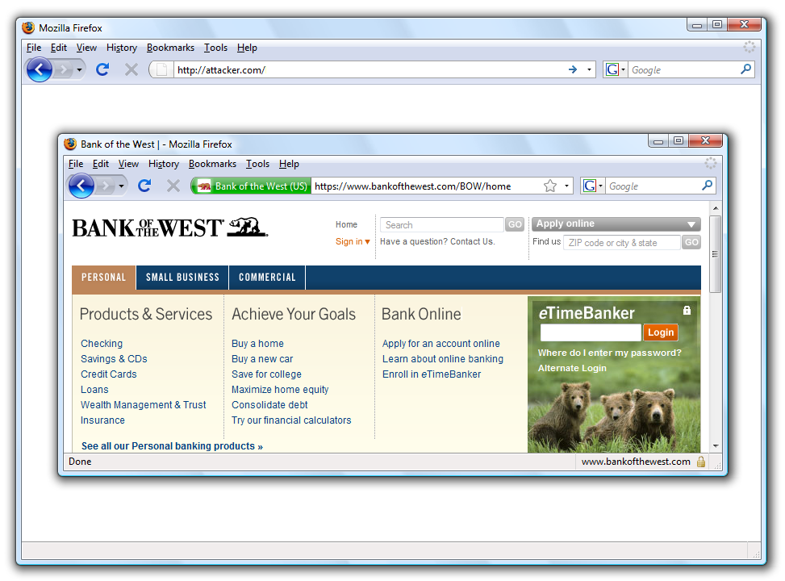
Safe to type your password?

Slide 8
Mixed Content: HTTP and HTTPS
Problem
Page loads over HTTPS, but has HTTP content
Network attacker can control page
IE: displays mixed-content dialog to user
Flash files over HTTP loaded with no warning (!)
Note: Flash can script the embedding page
Firefox: red slash over lock icon (no dialog)
Flash files over HTTP do not trigger the slash
Safari: does not detect mixed content

Slide 9
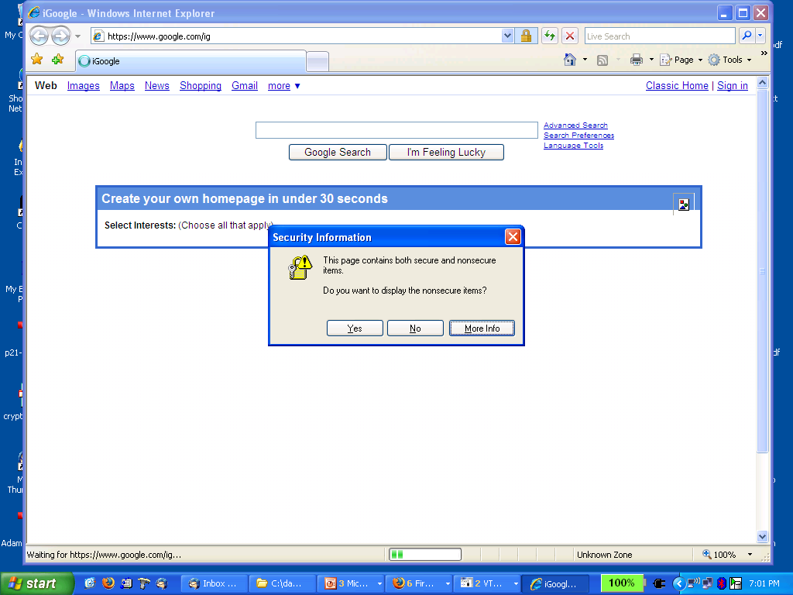
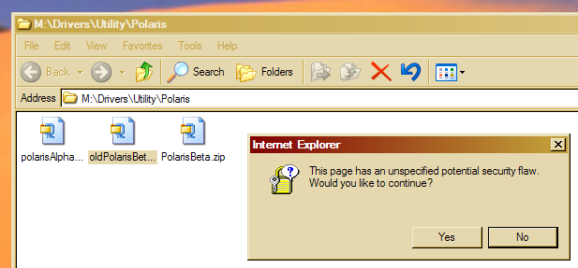
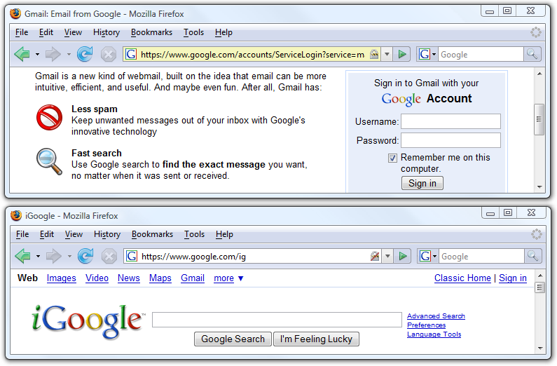
Mixed Content: HTTP and HTTPS
silly dialogs

Slide 10
Mixed content and network attacks
banks: after login all content over HTTPS
Developer error: Somewhere on bank site write<script src=http://www.site.com/script.js> </script>
Active network attacker can now hijack any session
Better way to include content:
<script src=//www.site.com/script.js> </script>
served over the same protocol as embedding page

Slide 11
Lock Icon 2.0
Extended validation (EV) certs
Prominent security indicator for EV certificates
note: EV site loading content from non-EV site does
not trigger mixed content warning

Slide 12
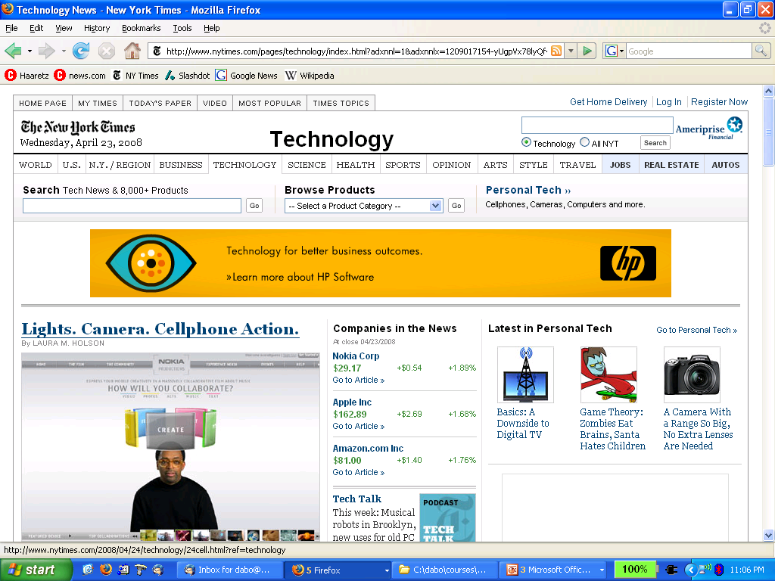
Finally: the status Bar
Trivially spoofable
<a href=“http://www.paypal.com/”
onclick=“this.href = ‘http://www.evil.com/’;”>
PayPal</a>

